Slide 1

Small Business Administration Loan Data: An Analysis on The Risk of Non-Payment
Created by Kevin Arnold, Brittany Roberts, and Sebastian Rolett

Slide 2
Agenda
Data Sources Utilized
Creation of Model
Performance of Model
Summary
Q&A

Slide 3
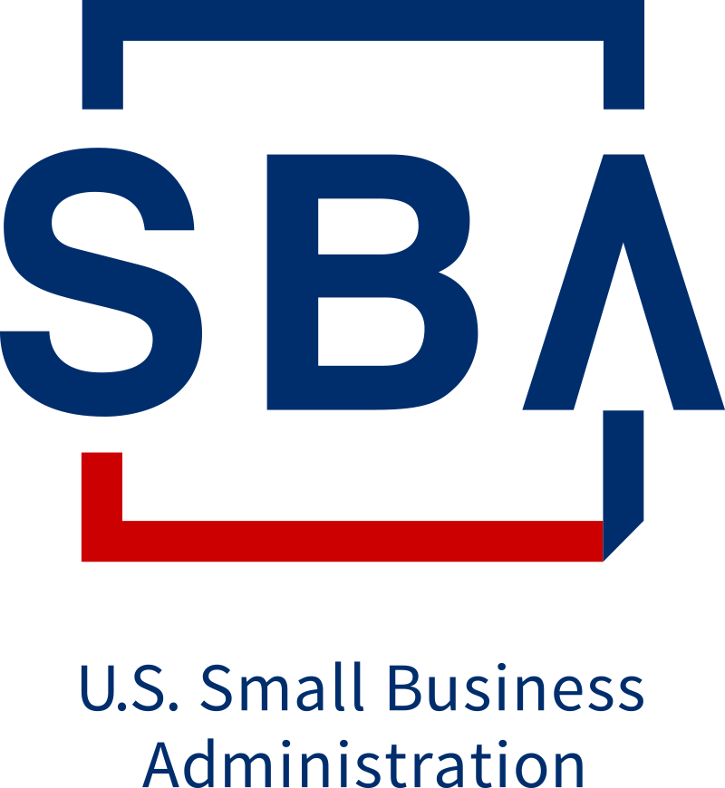
Data Sources Utilized
Data Sources
SBA Loan Data
FOIA - 7(a)(FY1991-FY1999) as of 230930.csv
FOIA - 7(a)(FY2000-FY2009) as of 230930.csv
FOIA - 7(a)(FY2010-FY20199) as of 230930.csv
FOIA - 7(a)(FY2020-Present) as of 230930.csv
16 columns with 1,272,851 rows
Notes:
Data is updated quarterly. Last updated on 9/30/2023.

Slide 4
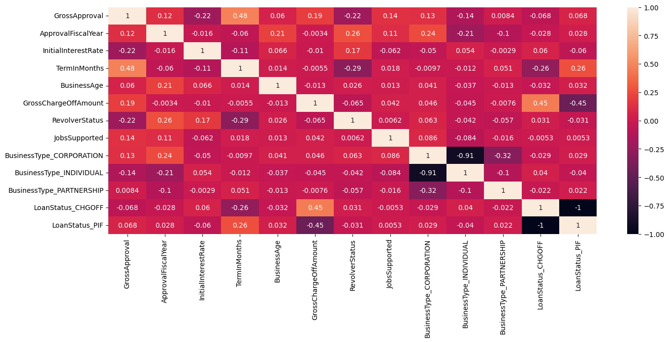
Creation of Model
Pre-Processing of Data
Datasets merged to have all dates from 10-01-1990 – present in one dataset
Rows were removed where LoanStatus column was not either Paid in Full (PIF) or Charged Off (CHGOFF)
Encoded BusinessType and LoanStatus for ease of use in model
Correlations of features to determine best features to use (Figure 1)
No feature had high correlation with a loan that was PIF except CHGOFF had a correlation of -1.
Figure 1
Features used in model: GrossApproval, ApprovalFiscalYear, InitialInterestRate, TermsinMonths, BusinessAge, JobSupported, BusinessType(Corporation, Individual, and Partnership), and LoanStatus(CHGOFF and PIF)

Slide 5
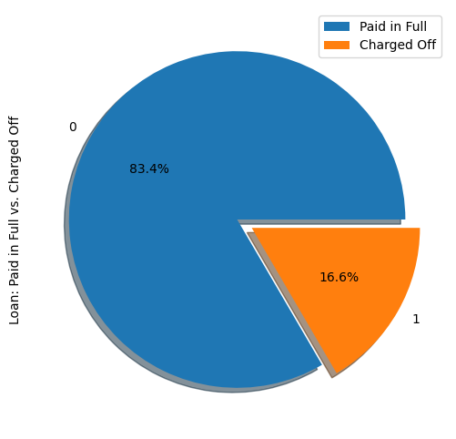
Performance of Model
Model 1
Logistic Regression
Training set: 70% of dataset
Test set: 30% of dataset
Accuracy score: 83%
317,601 of 381,856 correct
Precision
Paid in Full: 0.84
Charged Off: 0.40
Recall
Paid in Full: 0.99
Charged Off: 0.02
Figure 2
Notes:
Accuracy:
Imagine you are a basketball player practicing free throws. Accuracy is like measuring how many shots you make out of all the shots you attempt. If you make 8 shots out of 10, your accuracy is 80%. So, in the context of a model, accuracy tells you how often your model's predictions are correct out of all the predictions it makes.
Precision:
Now, let's say you are sorting out colored marbles into two buckets: red and blue. Precision is like measuring how many of the marbles you put into the red bucket are actually red. If you put 4 red marbles and 1 blue marble in the red bucket, your precision is 80% (4 out of 5). In terms of a model, precision tells you how many of the predicted positive instances are actually positive.
Recall:
Continuing with the marble analogy, recall is like measuring how many of the actual red marbles you managed to put in the red bucket. If there are 6 red marbles in total and you put 4 of them in the red bucket, your recall is 67% (4 out of 6). In the context of a model, recall tells you how many of the actual positive instances your model managed to capture.

Slide 6
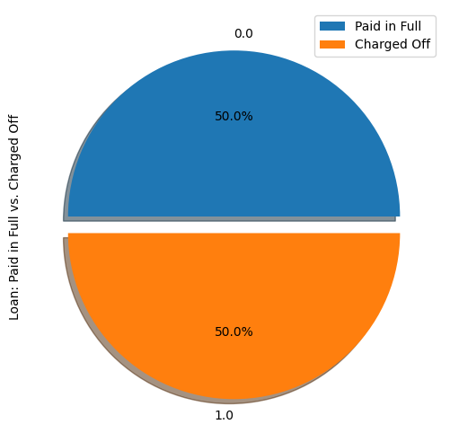
Performance of Model
Figure 3
Model - SMOTE
Logistic Regression
Training set: 70% of dataset
Test set: 30% of dataset
Accuracy score: 72%
274,936 of 381,856 correct
Precision
Paid in Full: 0.94
Charged Off: 0.35
Recall
Paid in Full: 0.71
Charged Off: 0.79
Notes:
SMOTE generates synthetic examples by finding the neighbors of existing minority class examples and creating new samples along the lines connecting them. This helps in training machine learning models to better recognize and handle the minority class.
Blends features from other minority examples to create more new samples.
Model 1
Accuracy score: 83%
317,601 of 381,856 correct
Precision
Paid in Full: 0.84
Charged Off: 0.40
Recall
Paid in Full: 0.99
Charged Off: 0.02

Slide 7
Performance of Model
Figure 4
Model – NearMiss
Logistic Regression
Training set: 70% of dataset
Test set: 30% of dataset
Accuracy score: 59%
225,295 of 381,856 correct
Precision
Paid in Full: 0.89
Charged Off: 0.23
Recall
Paid in Full: 0.58
Charged Off: 0.63
Notes:
NearMiss selects examples from the majority class that are close to the decision boundary (the line that separates the two classes). By doing this, it aims to balance the class distribution and improve the model's ability to predict the minority class.
Picture a classroom with two types of students: "math lovers" and "history buffs." If there are way more math lovers, NearMiss is the teacher who says, "Let's make things even" and decides to remove some of the math lovers from the class so that you have an equal number of both.
SMOTE Model
Accuracy score: 72%
274,936 of 381,856 correct
Precision
Paid in Full: 0.94
Charged Off: 0.35
Recall
Paid in Full: 0.71
Charged Off: 0.79
Model 1
Accuracy score: 83%
317,601 of 381,856 correct
Precision
Paid in Full: 0.84
Charged Off: 0.40
Recall
Paid in Full: 0.99
Charged Off: 0.02

Slide 8
Summary
 | Model 1 | Model – SMOTE | Model - NearMiss
Accuracy | 83% | 72% | 59%
Recall PIF: CHGOFF: | 0.99 0.02 | 0.71 0.79 | 0.63 0.58
Precision PIF: CHGOFF: | 0.84 0.40 | 0.94 0.35 | 0.89 0.23

Slide 9
Q&A

